Slide 1


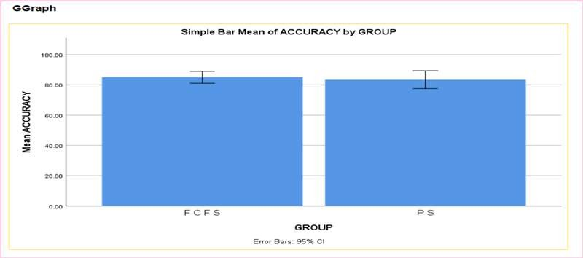
Name: Mr. V.VAMSI Register number: 192212079
Guided by Dr. R.DINESH KUMAR
Ms. Poorani.S
Guided by Dr. Mary Valantina. G
Short time task management system for increasing productivity by using priority scheduling comparing with first come first sreve (FCFS).
INTRODUCTION
While first-come-first-serve may seem straightforward, it often fails to account for the varying levels of urgency and importance inherent in tasks.
By prioritizing tasks effectively, users can ensure that critical deadlines are met without sacrificing productivity.
Moreover, our system offers unparalleled flexibility, allowing users to adapt their task management approach based on changing circumstances.
our platform empowers users to make informed decisions and allocate their resources strategically.
Tasks with looming deadlines may get overshadowed by less pressing matters, resulting in unnecessary delays and potential consequences.
The limitations of first-come-first-serve and embrace a new era of productivity and efficiency with our innovative platform.
Task management systems often feature collaboration tools such as shared task lists, comments, and file attachments, facilitating seamless communication and collaboration among team members.
Automated notifications and reminders keep users informed about upcoming deadlines, overdue tasks, or important updates, helping to prevent missed deadlines and ensure timely task completion.
Advanced task management systems may offer reporting and analytics capabilities, allowing users to gain insights into productivity trends, resource allocation, and project performance.
MATERIALS AND METHODS
Run FCFS Scheduling Algorithm
Start
Enter Number of Simulations Enter Number of Jobs
Generate Burst Time Per Job
Display scheduling Sequence
Exit
Run SJF Scheduling Algorithm
task management system algorithm
RESULTS
 | Algorithm | N | Mean | Std.Deviation | Std.error Mean
Accuracy | Priority Scheduling | 10 | 83.4000 | 8.24891 | 2.60853
 | First come First Sreve | 10 | 85.0000 | 5.53775 | 1.75119
In the present work, priority scheduling (PS) is compared with first come first sreve (FCFS) and it depicts that the proposed algorithm gives more accuracy when compared with the priority scheduling. First come first sreve outperforms in priority scheduling in task management system by better handling binary outcome prediction and proving more accurate classification
DISCUSSION AND CONCLUSION
Based on T-test Statistical analysis, the significance value of p=0.95 (independent sample T - test p>0.05) is obtained and shows that there is a statistical significant difference between the group 1 and group 2.
Overall , the accuracy of the priority scheduling (PS) is 50.00 % and it is better than the other algorithm.
First come first sreve (FCFS) - 45.00%
Priority Scheduling (PS) - 50.00%
deadline scheduling (DS) - 33.33%
Round Robin scheduling(RRS) - 30.22%
Earliest deadline first (EDF) - 35.12%
From the work , it is concluded that the priority scheduling algorithm attains the high accuracy when comparing with other first come first sreve Algorithm of task management system.
In predictive health analysis, logistic regression offers superior classification performance for binary outcome compared to linear regression suitability for continuous outcome prediction.
Overemphasizing priority might lead to neglecting less critical but still necessary tasks, causing delays or inefficiencies in overall task management system offers advantages in terms of efficiency and meeting deadlines but should be implemented judiciously to maintain fairness and effectiveness in resource utilization.
BIBLIOGRAPHY
Cleland-Huang, J., et al. (2005). Goal-centric traceability for managing non-functional requirements. Proceedings of the 27th international conference on Software engineering, ACM.
Cleland-Huang, J., et al. (2006). The detection and classification of non-functional requirements with application to early aspects. Requirements Engineering, 14th IEEE International Conference, IEEE.
Cleland-Huang, J., et al. (2007). "Automated classification of non-functional requirements." Requirements Engineering 12(2): 103-120.
Cysneiros, L. M. and J. C. S. do Prado Leite (2004). "Nonfunctional requirements: From elicitation to conceptual models." IEEE transactions on Software engineering 30(5) 328-350.
Dan, L., et al. (2013). Research of text categorization on WEKA. Intelligent System Design and Engineering Applications (ISDEA), 2013 Third International Conference on, IEEE.
Dörr, J., et al. (2003). Eliciting efficiency requirements with use cases. Ninth international workshop on requirements engineering: foundation for software quality. In conjunction with CAiSE.
Dutoit, A. H., et al. (2007). Rationale management in software engineering, Springer Science & Business Media.
Berry, P., K. Conley, M. Gervasio, B. Peintner, T. Uribe, and N. Yorke-Smith. 2006. Deploying a personalized time management agent. In 5th International Joint Conference on Autonomous Agents and Multi Agent Systems (AAMAS-06) Industrial Track, Hakodate, Japan, pp. 1564–1571.
Chin J. P., V. A. Diehl, and K. L. Norman. 1988. Development of an instrument measuring user satisfaction of the human–computer interface. In Proceedings of ACM/SIGCHI, Washington, DC, pp. 213–218.

